Slide 1

CUSTOMER BUYING PATTERN

Slide 2
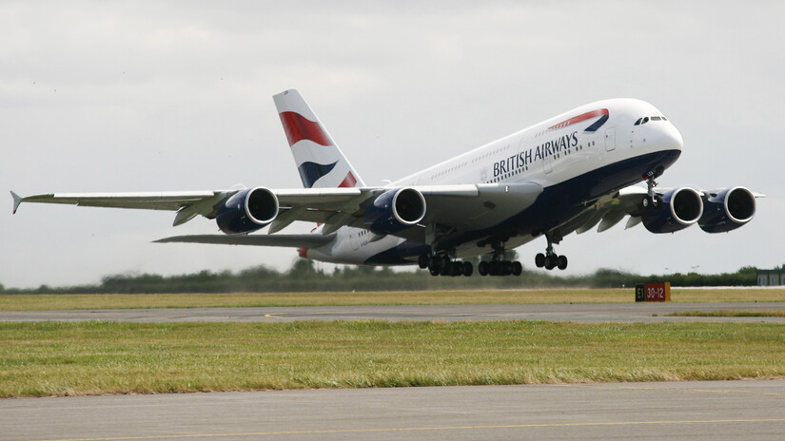
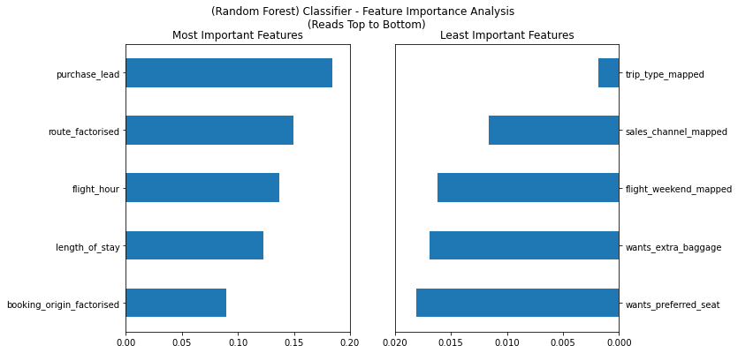
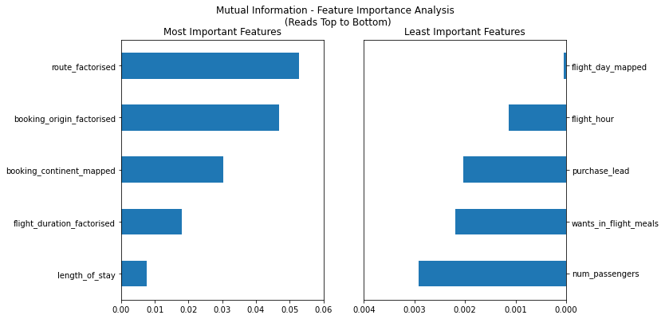
INFLUENCING FACTORS
‘Route’, ‘Length of stay’, and ‘Booking origin’ seem to be consistently ranked as important features for both ML models.
‘Flight weekend’ is derived from ‘Flight day’, so are essentially the same, and these don’t seem to play an important role.
*Variables appear with the suffix ‘mapped’ as they have been enumerated for easier processing. No loss of information has occurred in this process.
Models used have a score of 85%+ accuracy, hence the results are highly reliable.

